Slide 1

Welcome! Moikkulis (or moi)! While waiting for us to start:
Please ensure that your microphone is muted during the presentation. But we’d love if you could unmute yourself temporarily (by pressing the spacebar or CMD+A):
To giggle or laugh
To comment / ask questions
If you would like to turn on your video, great! It would be nice to see everyone. Otherwise, we respect your privacy and prerogative ☺
We will be recording today’s session (excluding breakout)
Issues with the Zoom? Burning questions to ask? Please use zoom chat box. I will check it!
@mkveerapen
veerapen@broadinstitute.org
#HyväSuomi

Slide 2


FinnGen Sandbox training
December 8th, 2021
Kumar Veerapen, PhD
veerapen@broadinstitute.org
https://sandbox.finngen.fi

Slide 3
Outline
What is FinnGen?
Overview of the Sandbox
FinnGen Data Structure and Permissions
Costs of using the Sandbox
Breakout room activities
Additional resources
Please fill our post-training survey here: https://forms.gle/HzY5XDDx9XUGyPxR8

Slide 4
Generating Results from FinnGen
Population samples
321 400
individuals
Combined genotype and register data
Imputation
Total markers: 16,962,023
Genotyping
(655,973 markers)
National register data
Hospital biobank samples
Blood Service’s biobank
Association analyses
Current data freeze for release 7:
4,149 endpoints

Slide 5
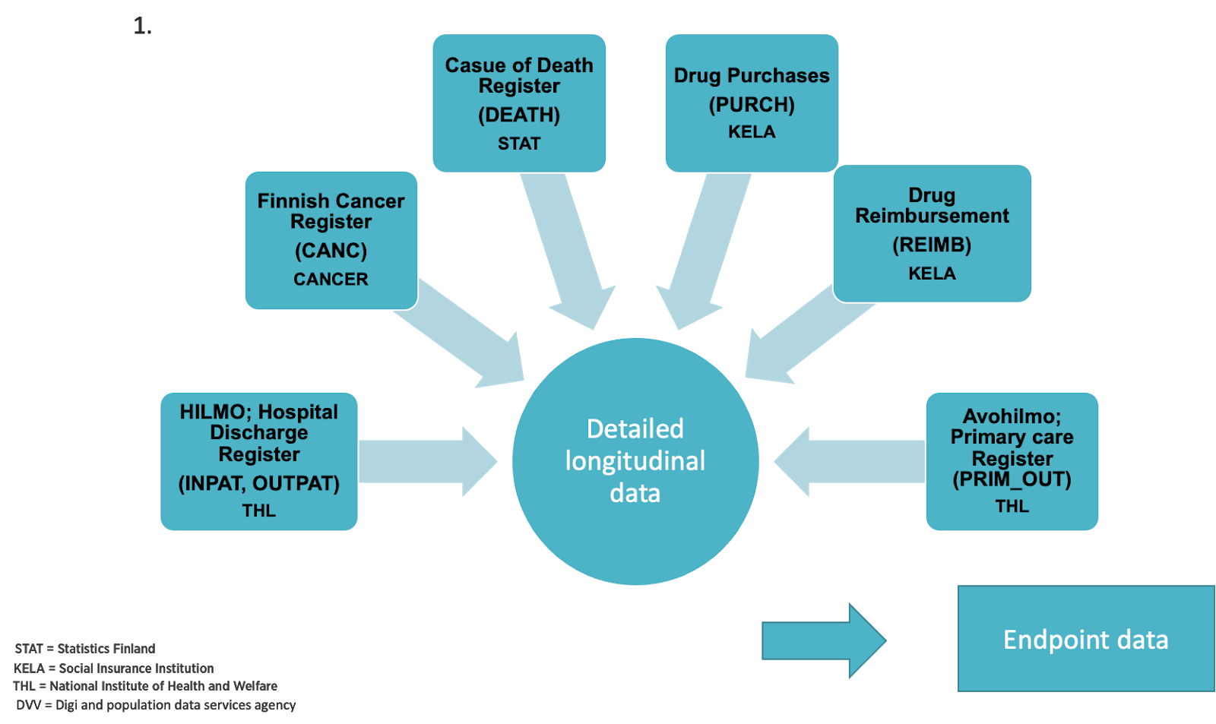
Endpoint Curation

Slide 6
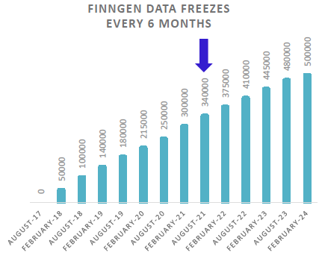
FinnGen Current Data Freeze
Welcome to an expedition to the frontier of genomics and medicine!
321 400
Individuals
16 962 023
Variants
4 149
Phenotypes
(Release 7)

Slide 7
FinnGen Sandbox v8.1 for Data Access
Cloud-based (GCP) browser platform
Target audience:
Analysts
Physician-scientists
Many more…!
IVM to access data and run analysis and access the Sandbox tools
https://sandbox.finngen.fi
IVM
Notes:
GCP -- Google Cloud Platform
IVM – Interactive Virtual Machine
Home directory 1TB
Notes:
Backend is Google Cloud Platform (GCP) for reliability and scalability.

Slide 8
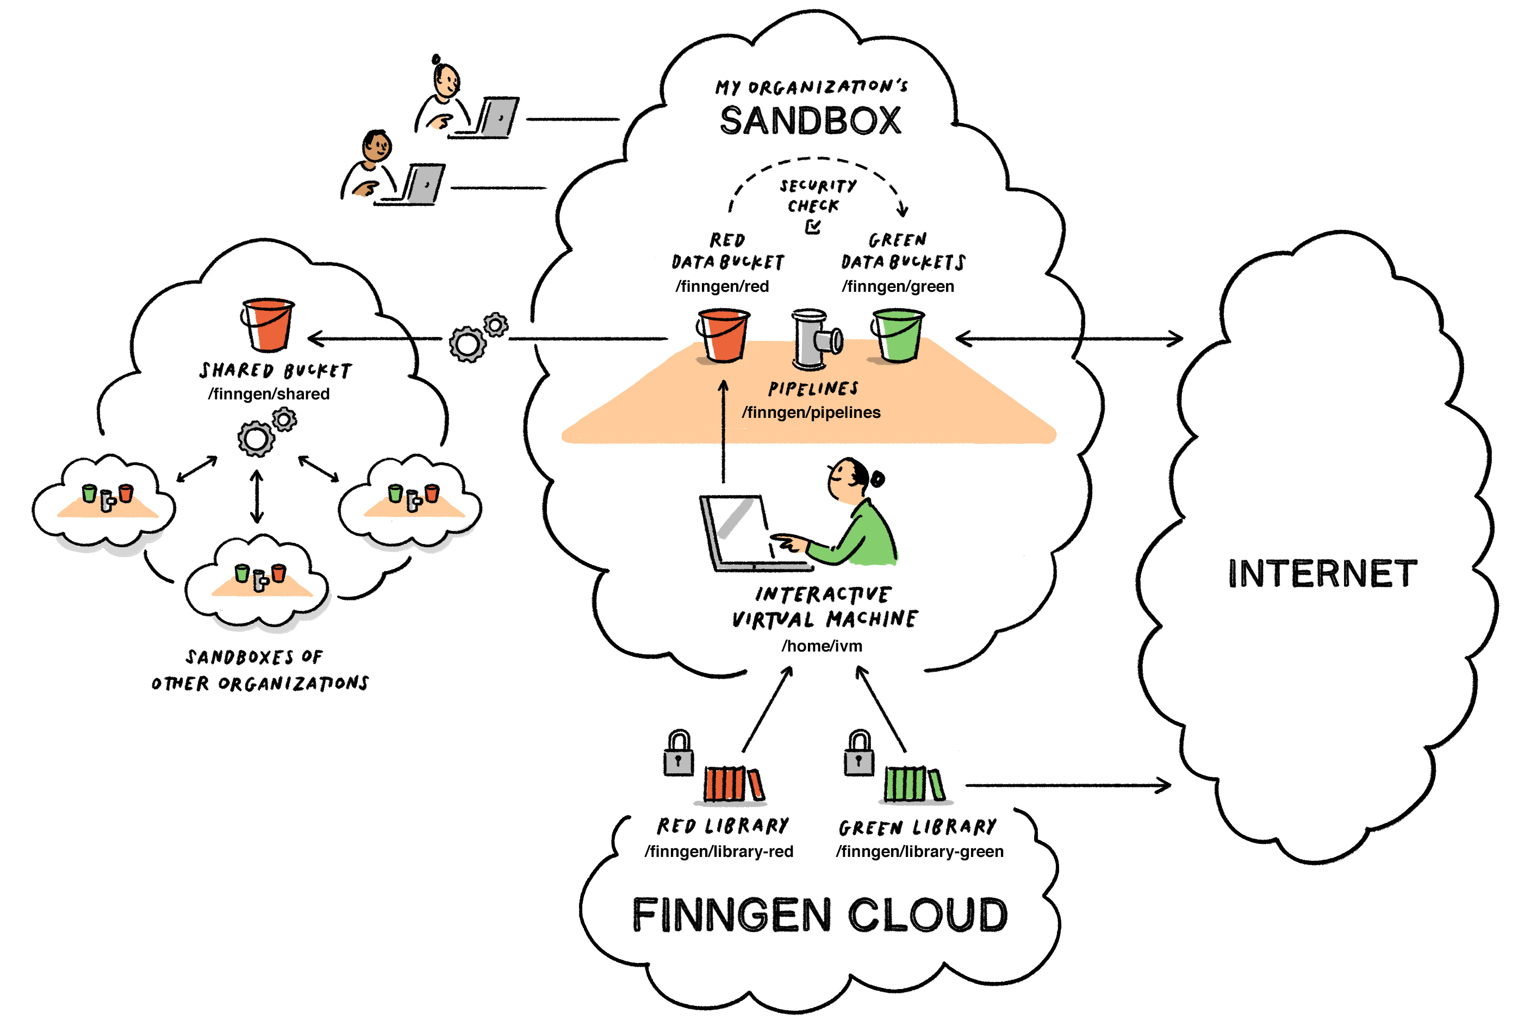
Sandbox Empowers FinnGen Users
This is on your Sandbox landing/desktop page
Notes:
Present from bottom up

Slide 9
FinnGen data access levels and account types
Individual level data
Aggregate data
Raw data
Processing of
Raw genotypes
Raw registry data
FinnGen Data
Browsing and analyses
Imputed/chip genotypes
Disease endpoints and ages
Minimum phenotype data
Longitudinal data
FinnGen results
Browsing and discovery, PheWeb https://results.finngen.fi
Access
1. Administrators only
Access
FinnGen partners
Analysts
Heavier user identification
Access
FinnGen partners
”Tier 2” partners (restricted)
Academic research partners
Others?
THL server and FinnGen Factory
FinnGen RED Library in Sandbox
FinnGen GREEN Library in Sandbox

Slide 10
Green vs Red Libraries?
Green Library
Red Library
The Green library bucket contains the core analysis results and other general information of the data.
Core analysis results (GWAS summary stats, conditional analysis, fine-mapping)
Endpoint counts
Statistics of imputed genotypes and other annotation of variants
Release 3 analysis document: /finngen/library-green/R3/FinnGen_R3_analysis.pdf
Green can be accessed by local computer using gsutil
The Red library bucket contains individual level data.
Individual imputed genotypes
Endpoint definitions
Endpoint phenotypes
Longitudinal phenotypes
Covariate data
Genotype data path: /finngen/library-red/ finngen_R6/finngen_R6_genotype_1.0/ finngen_R6_genotype_readme
(IVM File Manager: /finngen/library-red)
(IVM File Manager: /finngen/library-green)
Notes:
Green can be accessed by local computer using gsutil

Slide 11
FinnGen data access levels and account types
IVM File Manager Path Description
/finngen/library-red N/A
Individual personal FinnGen data: Phenotype, Genotype data
/finngen/library-green gs://finngen-production-library-green/
Analysis results, summary data
/finngen/pipelines
N/A
Shared output from the pipeline. Can contain personal data.
/finngen/green gs://fg-production-sandbox-
<No. sandbox>_green/*
Accepted download results,
Researcher’s own data.
/finngen/red
N/A
Researcher’s analysis results from IVM, shared with own organisation
/finngen/shared
N/A
Data that SB-user has shared with all sandboxes Shared with all Finngen partner organizations with SB-access
Tip: See IVM desktop file “buckets.txt” for specific addresses to your Sandbox
Red = can contain personal data
Green = no personal data
* No. of sandbox is given to each when access to production sandbox is granted

Slide 12
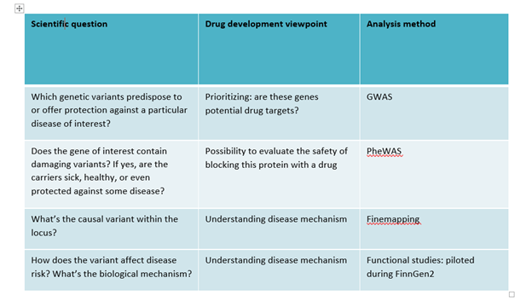
Questions you can ask?

Slide 13
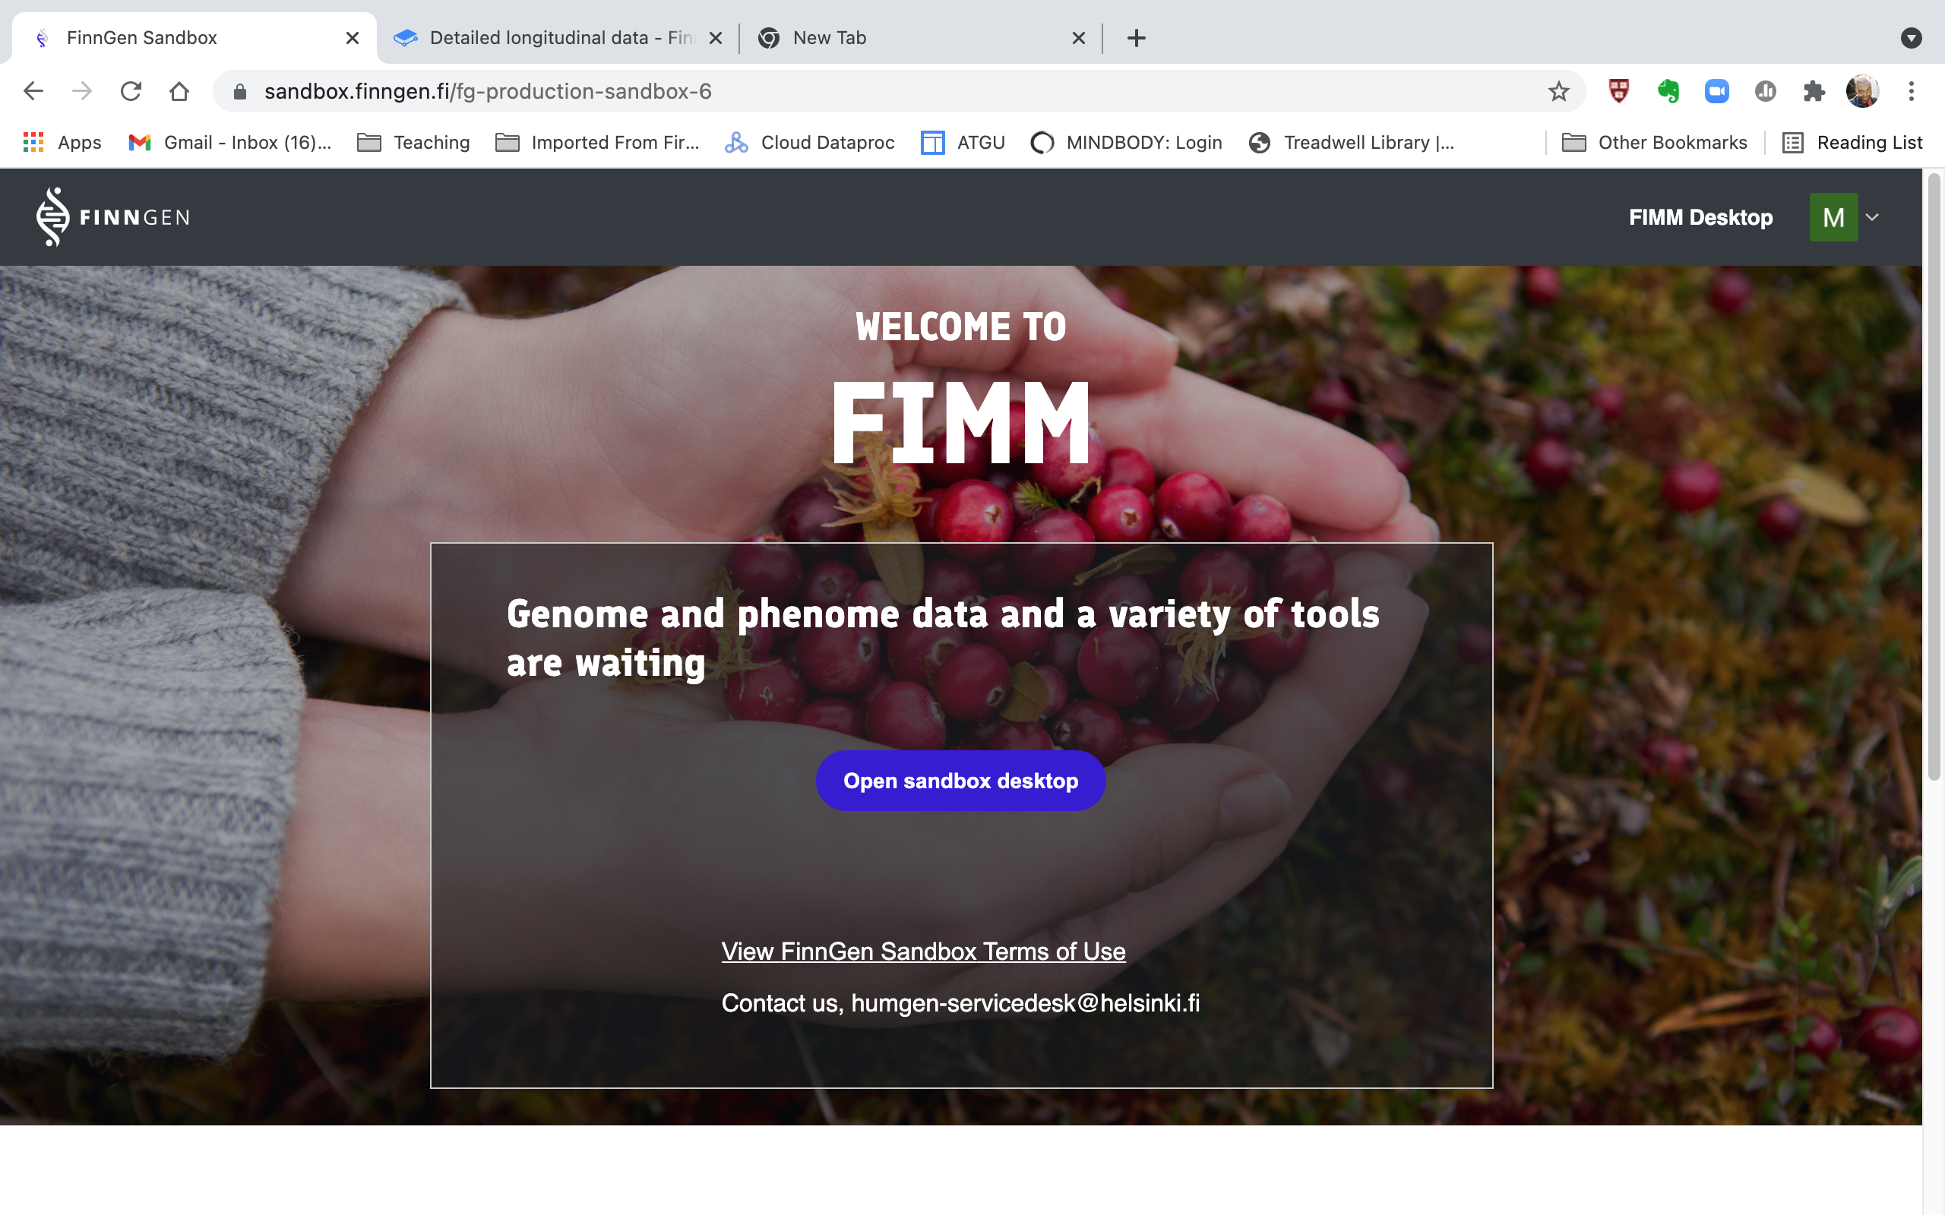
Watch tutorial on 2FA
Logging in
Log in to sandbox: https://sandbox.finngen.fi
Important: You may only access Sandbox with a secure computer.
The FinnGen account must be configured for two factor authentication (2FA) for login.
Notes:
Two-factor authentication strengthens the security of computer accounts by requiring a second authentication method

Slide 14
Costs
~ 240 €/month/sandbox: mainly, Cloud FileStore
If your organization has not arranged for separate billing, your choice of IVM configurations will be limited to the “Basic machine”.
Name
Description
Average cost
Basic machine
Advanced machine
Rather big machine
1 processor, 3.75 GB memory
4 processors, 15 GB memory
16 processors, 104 GB memory
0,04 €/h
0,20 €/h
1,10 €/h
Persistent disk storage (home folder) cost: 0.03 EUR/GB/month
Shutting down IVM, will reduce costs: unused IVMs shut down after two days.
Currently, FinnGen project will cover moderate analysis processing costs
Notes:
we are trying to reduce main cost this

Slide 15
Costs
Example :
Runtime costs estimates for processing 0.5 TB of genotype data in sandbox, task converting compressed flat text genotype data (vcf.gz) into binary format (bgen).
Job done
Run type
Run time h:m
Costs total (€), calculated
IVM: Basic machine (1 CPU)
Serial
29:48
€ 1,5
IVM: Rather big machine (16 CPU)
Parallel
3:08
€ 3,0
Pipeline (4 CPU), on demand
Parallel
1:50
€ 8,7
Pipeline (4 CPU), preemptible machines
Parallel
1:50
€ 1,8

Slide 16
Let’s try this together
In your breakout rooms:
Pick a someone to screen share
Pick a note taker who will
Create a live Google Doc / notepad / word doc for the group
Take notes
Everyone to go through the Google Doc action items
Smile and have a great time (videos on, hopefully)
Where is the Google Doc? In your zoom chat
Helpful link:
Analyst Handbook: https://app.gitbook.com/@finngen/s/finngen-analyst-handbook/
Notes:
for this entire activity, you will need to have Sandbox access AND be configured for 2FA
You need to have your @FinnGen.fi ID ready
Notes:
https://docs.google.com/document/d/1behL53F4IJWH4XoHMYvmxR9_jYny5xDI5SQ9fIGAHN0/edit?usp=sharing

Slide 17
Help & General info
finngen.fi website and finngen.fi member’s area
General information and login to finngen.fi members area (with @finngen.fi account)
Member's area: links to tools and resources and online forms, other important docs, users’ meeting videos
The FinnGen Analyst Handbook
Permanent link to the Handbook in the finngen.fi members area
Sandbox support & IT help: humgen-servicedesk@helsinki.fi
Program installation requests, bug & error reporting
Sandbox tutorial site
Training material and the data security exam to be repeated annually
FinnGen Community Slack
Community Slack for questions and connecting with FinnGen researchers & staff, various channels
FinnGen All Sharepoint
Documents, incl. all users’ meeting materials, and FinnGen analysis proposals
Login with your company email (not connected to @finngen.fi account!)
Recordings of the previous trainings & other Sandbox training materials (in FinnGen All Sharepoint)
Do you need access? Contact: humgen-servicedesk@helsinki.fi

Slide 18
Emailing lists
Published about 4 times a year, contains useful updates and important links
General: finngen-all@helsinki.fi
Finngen.fi account holders (green and red data access holders): finngen-accounts@helsinki.fi
FinnGen Sandbox users list: fg-sbx-all@helsinki.fi
FinnGen Analysis group list: finngen-analysis@helsinki.fi
Invited to the FinnGen Scientific Committee & Analysis group calls Tue (monthly)
FinnGen newsletter
Do you want to be added or removed from one of the emailing lists or newsletter? Contact: humgen-servicedesk@helsinki.fi

Slide 19
Custom data look-ups & endpoint questions
Specific data look-up requests: finngen-lookups@helsinki.fi
Specific data look-ups (eg. how many this and that code/patient/variant is there in FinnGen data?)
Remember that some of these questions can also be answered by
Risteys
PheWeb
Atlas (in Sandbox)
Specific R-libraries (in Sandbox)
Endpoint questions: finngen-endpoints@helsinki.fi or #endpoints in the FinnGen Community Slack

Slide 20
Data Protection
Data Protection:
For any data protection concern or matter, contact our Data Protection Officer by:
email grp-finngen-dpo@helsinki.fi
phone: +358 50 306 96 98
If you suspect a data breach, report immediately by:
the electronic reporting form: https://elomake.helsinki.fi/lomakkeet/103627/lomake.html
or contact directly the DPO (see the email or phone above)

Slide 21
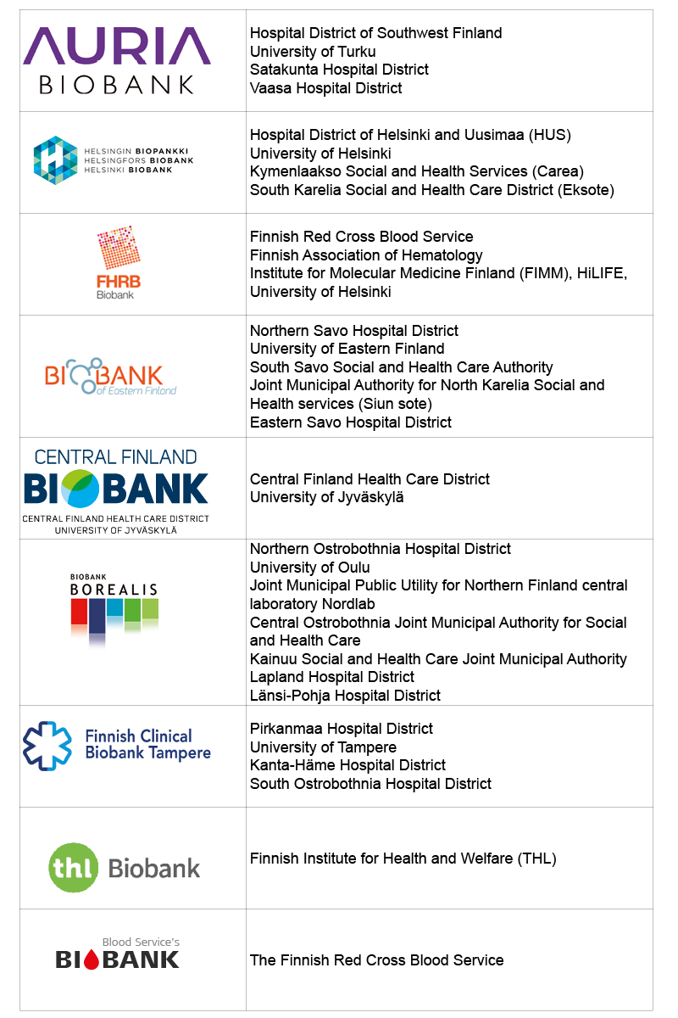






FinnGen Partners
Coordinating partners:
Biobanks:
Funding partners:
Funding:

Slide 22
Suuri kiitos! Onko kysyttävää?
December 8th, 2021
Kumar Veerapen, PhD
veerapen@broadinstitute.org
https://sandbox.finngen.fi
Please fill our post-training survey here: https://forms.gle/HzY5XDDx9XUGyPxR8

